Slide 1

IOT LAB EXPERIMENTS
Sensors Actuators
Department of Computer Science and Engineering, BMS College of Engineering

Slide 2
LDR(Light Dependent Resistor)
A photoresistor (or light-dependent resistor, LDR, or photocell) is a light-controlled variable resistor.
The resistance of a photoresistor decreases with increasing incident light intensity
In other words, it exhibits photoconductivity.

Slide 3

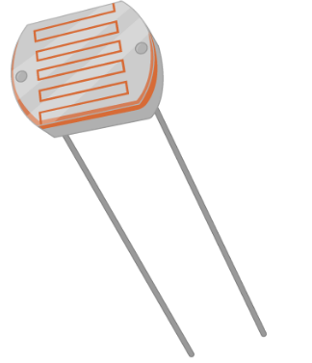
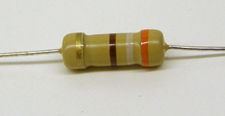
Nightlight Simulation(Photo Sensor)

Slide 4
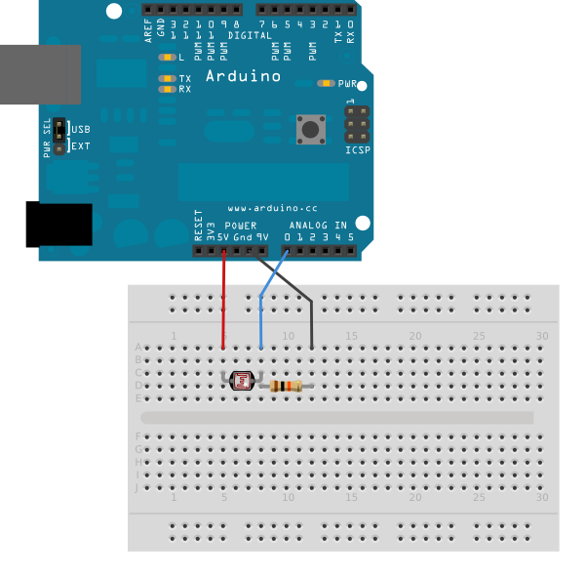
Nightlight Simulation(Photo Sensor)

Slide 5
Code…
int light_sensitivity = 500; //This is the approx value of light surrounding your LDR
void setup()
{
Serial.begin(9600); //start the serial monitor with 9600 buad
pinMode(11, OUTPUT);
}
void loop()
{
int LDRValue = analogRead(A0); //reads the ldr’s value through LDR
Serial.println(LDRValue); //prints the LDR values to serial monitor
delay(50); //This is the speed by which LDR sends value to arduino
if (LDRValue < light_sensitivity)
digitalWrite(11, HIGH);
else
digitalWrite(11, LOW);
delay(1000);
}

Slide 6
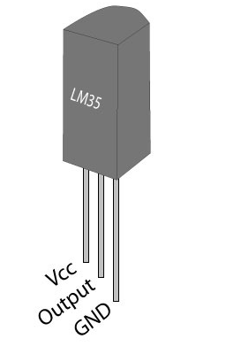
Temperature Sensor

Slide 7
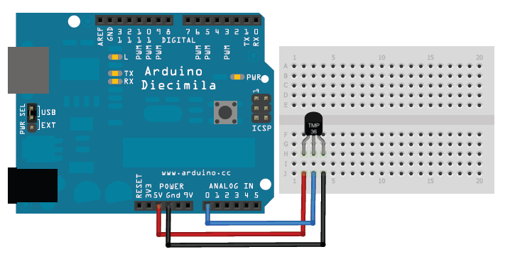
Temperature Sensor(1)

Slide 8
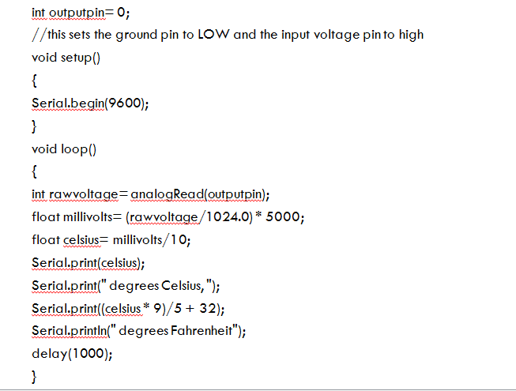

Slide 9
Temperature Sensor(3)
temp = (5.0 * analogRead(tempPin) * 100.0) / 1024;
The original equation came from taking the reading, finding what percentage of the range (1024) it is, multiplying that by the range itself(aRef, or 5000 mV), and dividing by ten (10 mV per degree Celcius(Linear temperature slope), according to the datasheet.

Slide 10
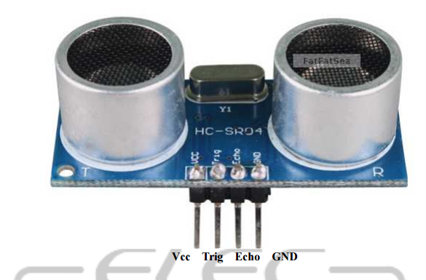
Ultrasound Sensor(1)

Slide 11
Ultrasound Sensor(2)
Ultrasonic ranging module HC - SR04 provides 2cm - 400cm non-contact measurement function
The ranging accuracy can reach to 3mm.
The modules includes ultrasonic transmitters, receiver and control circuit.
VCC: +5VDC
Trig : Trigger (INPUT)
Echo: Echo (OUTPUT)
GND: GND

Slide 12
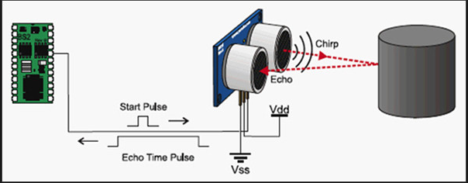
Working Principle(1)

Slide 13
Working Principle(2)
The modules includes ultrasonic transmitters, receiver and control circuit.
The basic principle of work:
(1) Using IO trigger for at least 10us high level signal,
(2) The Module automatically sends eight 40 kHz pulse and detect whether there is a pulse signal back.
(3) IF the signal back, through high level , time of high output IO duration is the time from sending ultrasonic to returning.
Test distance = (high level time×velocity of sound (340M/S) / 2,

Slide 14
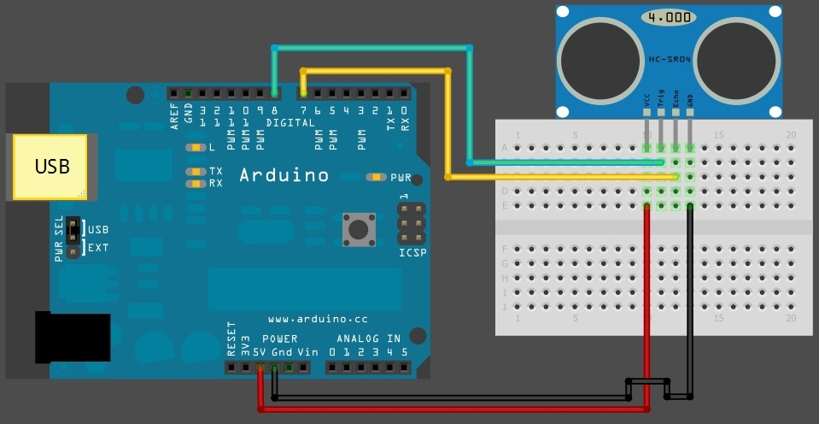
Distance Calculation with Ultrasound

Slide 15
Code for printing distance of an obstacle in serial monitor
const int trigPin = 2;
const int echoPin = 4;
void setup() {
// initialize serial communication:
Serial.begin(9600);
}

Slide 16
void loop()
{
pinMode(trigPin, OUTPUT);
digitalWrite(trigPin, LOW);
delayMicroseconds(2);
digitalWrite(trigPin, HIGH);
delayMicroseconds(10);
digitalWrite(trigPin, LOW);
pinMode(echoPin, INPUT);
duration = pulseIn(echoPin, HIGH);
inches = microsecondsToInches(duration); // convert time to distance
cm = microsecondsToCentimeters(duration);
Serial.print(inches); Serial.print("in, ");
Serial.print(cm); Serial.print("cm");
Serial.println();
delay(1000);
}

Slide 17
long microsecondsToCentimeters(long microseconds)
{
// The speed of sound is 340 m/s or 29 microseconds per centimeter.
// The ping travels out and back, so to find the distance of the
// object we take half of the distance travelled.
return microseconds / 29 / 2;
}
long microsecondsToInches(long microseconds)
{
// According to Parallax's datasheet for the PING))), there are
// 73.746 microseconds per inch (i.e. sound travels at 1130 feet per
// second). This gives the distance travelled by the ping, outbound
// and return, so we divide by 2 to get the distance of the obstacle.
// See: http://www.parallax.com/dl/docs/prod/acc/28015-PING-v1.3.pdf
return microseconds / 74 / 2;
}

Slide 18
Reverse Parking Sensor
#include <NewPing.h>
int tonepin = 13;
//Attach positive leg of buzzer at 13 and negative leg to GND
-----------------------------------------------------
if(cm >0 && cm <10)
{
Serial.print("Less Distance");
tone(tonepin,2000,1000); //tone(pin, frequency(hertz), duration(milliseconds))
}
if (cm > 10)
{
noTone(8);
}

Slide 19
Procedure for including Newping.h
Instructions:
Download NewPing library from here: Download NewPing Library
Put the "NewPing" folder in "libraries\".
In the Arduino IDE, create a new sketch (or open one) and select from the menubar "Sktech->Import Library->NewPing".
Comment it all out like this in NewPing.cpp:
/* #if defined (__AVR_ATmega32U4__) // Use Timer4 for ATmega32U4 (Teensy/Leonardo). ISR(TIMER4_OVF_vect) { #else ISR(TIMER2_COMPA_vect) { #endif if(intFunc) intFunc(); // If wrapped function is set, call it. }*/

Slide 20
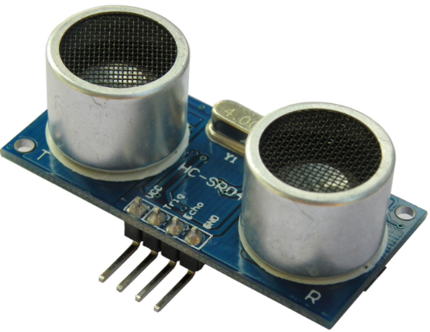
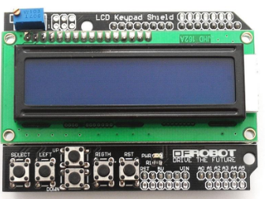
Distance display(LCD)-Ultrasound sensor(1)

Slide 21
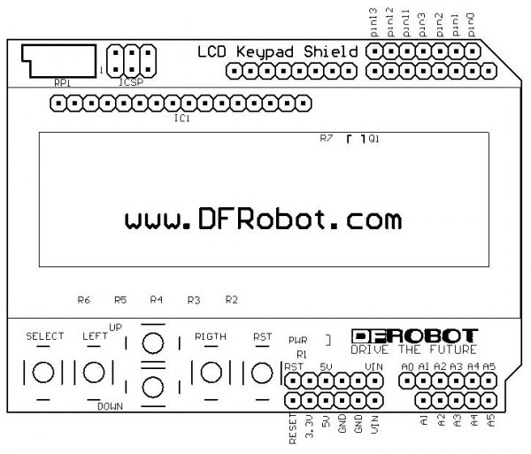
Distance display(LCD)-Ultrasound sensor(2)
Ultrasound Arduino
---------- --------
Echo 2
Trigger 3
Vcc 5 V
Gnd Gnd

Slide 22
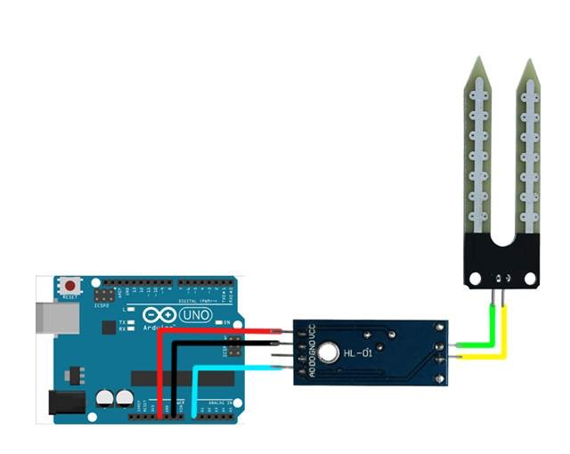
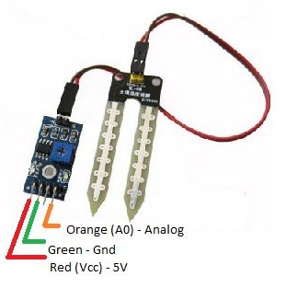
Moisture Sensor

Slide 23
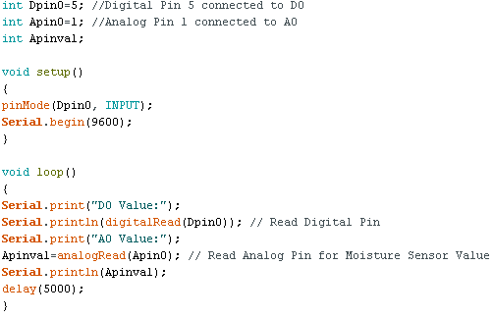

Slide 24
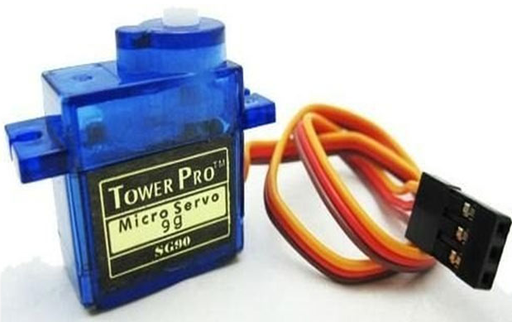
Servo Motor

Slide 25
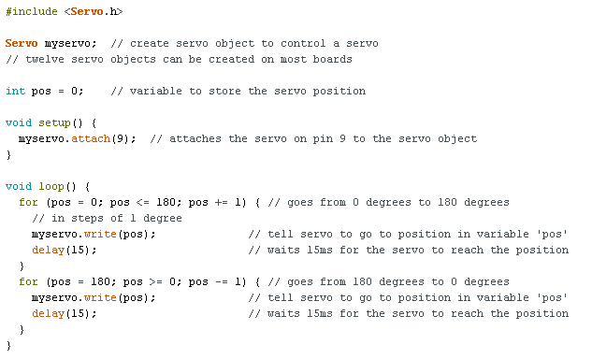
Servo Motor

Slide 26
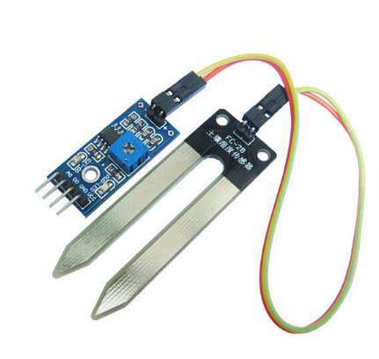
Automatic Irrigation Control Simulation(1)

Slide 27
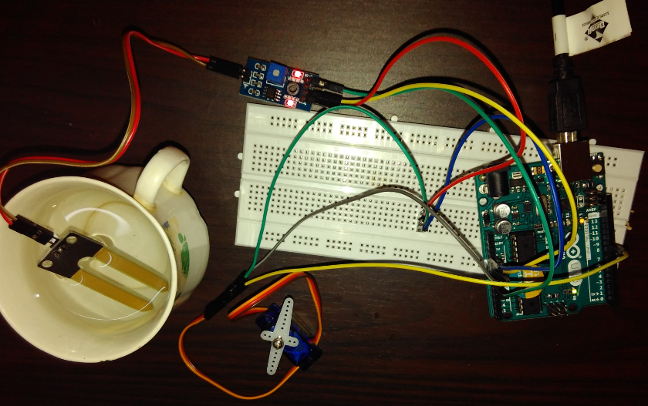
Automatic Irrigation Control Simulation(2)

Slide 28
Automatic Irrigation Control Simulation(3)
Moisture sensor VCC to Arduino 5V
Moisture sensor GND to Arduino GND
Moisture sensor A0 to Arduino A0
Servo motor VCC to Arduino 5V
Servo motor GND to Arduino GND
Servo Motor Signal to Arduino digital pin 9
Write the code to rotate servo motor when there is no moisture

Slide 29
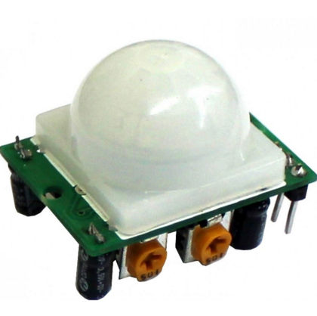
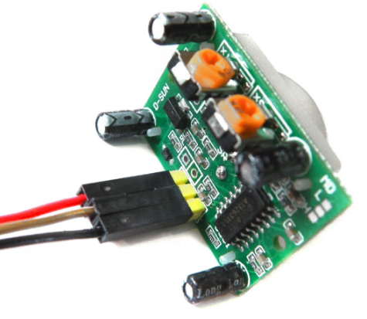
PIR(Passive Infrared Sensor)

Slide 30
PIR Sensor(1)
It measures infrared (IR) light radiating from objects in its field of view.
All objects with a temperature above absolute zero emit heat energy in the form of radiation. Usually this radiation isn't visible to the human eye because it radiates at infrared wavelengths
The term passive in this instance refers to the fact that PIR devices do not generate or radiate any energy for detection purposes. They work entirely by detecting the infrared radiation emitted or reflected from an object.

Slide 31
PIR Sensor(2)
An individual PIR sensor detects changes in the amount of infrared radiation impinging upon it, which varies depending on the temperature and surface characteristics of the objects in front of the sensor.
When an object, such as a human, passes in front of the background, such as a wall, the temperature at that point in the sensor's field of view will rise from room temperature to body temperature, and then back again. The sensor converts the resulting change in the incoming infrared radiation into a change in the output voltage, and this triggers the detection. Objects of similar temperature but different surface characteristics may also have a different infrared emission pattern, and thus moving them with respect to the background may trigger the detector as well.

Slide 32
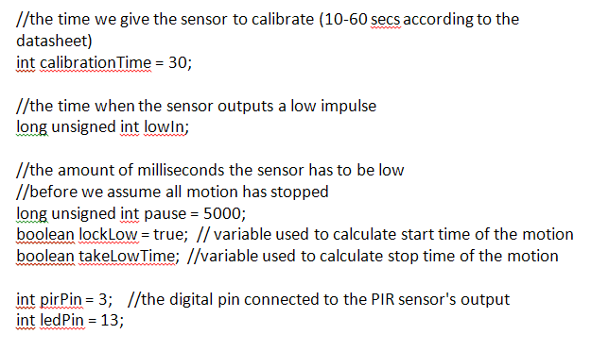
PIR Sensor code(1)

Slide 33
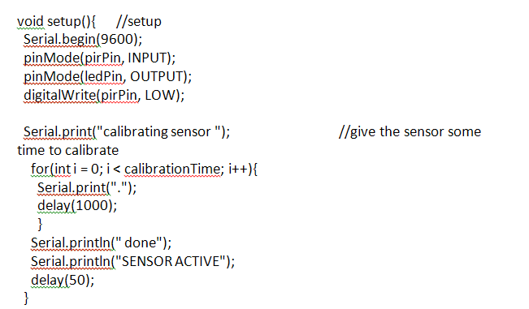
PIR Sensor code(2)

Slide 34
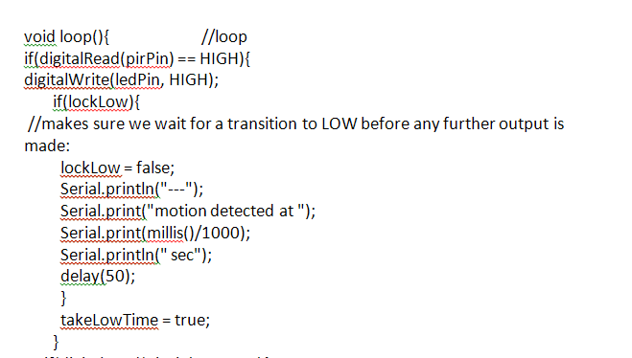
PIR Sensor code (3)

Slide 35
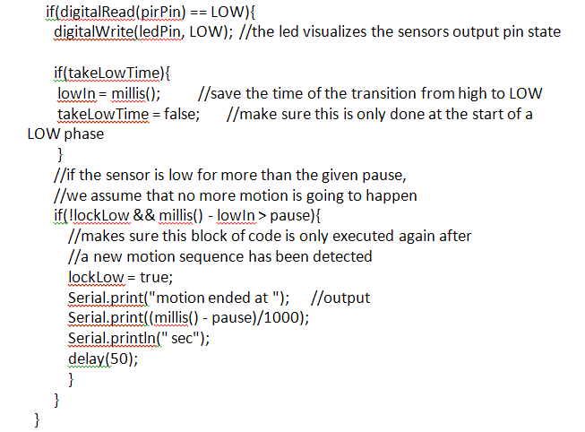
PIR Sensor code(4)

Slide 36
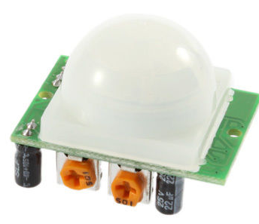
Nightlight Simulation on Human Presence(1)

Slide 37
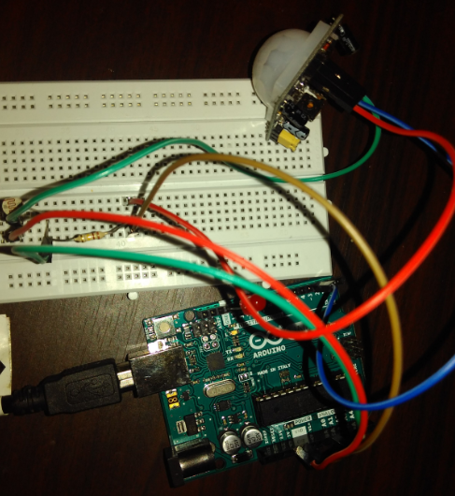
Nightlight Simulation on Human Presence(2)

Slide 38
Nightlight Simulation on Human Presence(3)
Connections:
Attach one leg of LDR to 5V and another leg to Arduino Analog pin A0
Attach one leg of 110K register with that leg of LDR connected to A0
Attach another leg of register to the ground
Connect the positive leg of LED to pin 11 and negative to GND
Connect positive leg of PIR to 5V
Connect negative leg of PIR to GND
Connect output pin of PIR to digital pin 3
Write the code to switch on LED only when there is movement and less light.

Slide 39
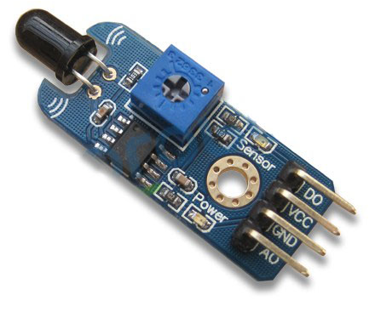
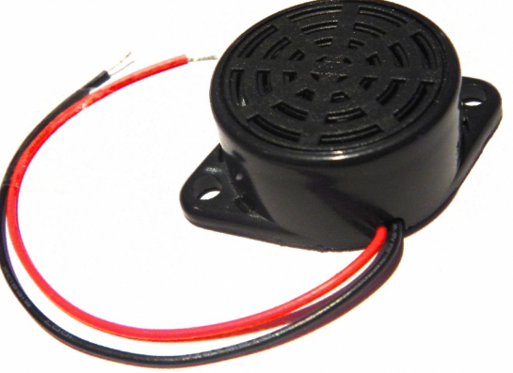
Fire Alert(1)

Slide 40
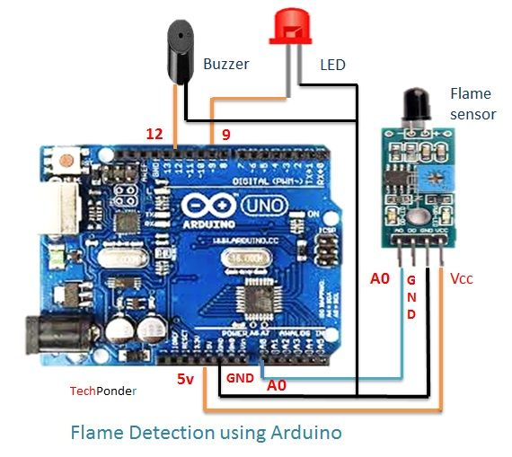
Fire Alert(2)

Slide 41
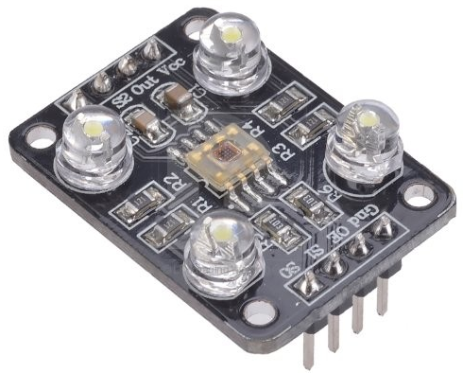
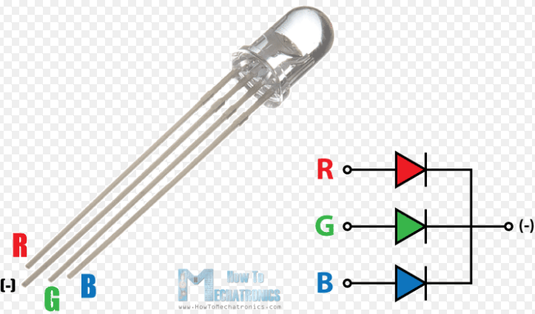
Color Recognition with RGB LED(1)

Slide 42
RGB LED Code(1)
int redPin = 11;
int greenPin = 10;
int bluePin = 9;
void setup()
{
pinMode(redPin, OUTPUT);
pinMode(greenPin, OUTPUT);
pinMode(bluePin, OUTPUT);
}
void setColor(int red, int green, int blue)
{
analogWrite(redPin, red);
analogWrite(greenPin, green);
analogWrite(bluePin, blue);
}

Slide 43
RGB LED Code(2)
void loop()
{
setColor(255, 0, 0); // red
delay(1000);
setColor(0, 255, 0); // green
delay(1000);
setColor(0, 0, 255); // blue
delay(1000);
setColor(255, 255, 0); // yellow
delay(1000);
setColor(80, 0, 80); // purple
delay(1000);
setColor(0, 255, 255); // aqua
delay(1000);
}

Slide 44
Color Recognition with RGB LED(1)
Color Sensor Arduino
----------- --------
VCC 5V
GND GND
s0 8
s1 9
s2 12
s3 11
OUT 10
OE GND
RGB LED Arduino
----------- --------
R 2
G 3
B 4

Slide 45
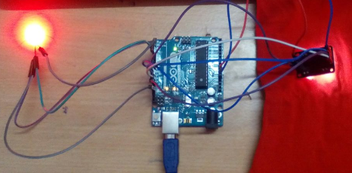
Color Recognition with RGB LED(3)
Write the code to glow according to color in front of the sensor.

